Slide 1

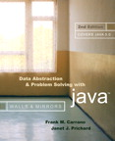
Chapter 6
Recursion as a Problem-Solving Technique

Slide 2

Backtracking
Backtracking
  A strategy for guessing at a solution and backing up when an impasse is reached
Recursion and backtracking can be combined to solve problems

Slide 3
The Eight Queens Problem
Problem
  Place eight queens on the chessboard so that no queen can attack any other queen
Strategy: guess at a solution
  There are 4,426,165,368 ways to arrange 8 queens on a chessboard of 64 squares

Slide 4
The Eight Queens Problem
An observation that eliminates many arrangements from consideration
  No queen can reside in a row or a column that contains another queen
    Now: only 40,320 arrangements of queens to be checked for attacks along diagonals

Slide 5
The Eight Queens Problem
Providing organization for the guessing strategy
  Place queens one column at a time
  If you reach an impasse, backtrack to the previous column

Slide 6
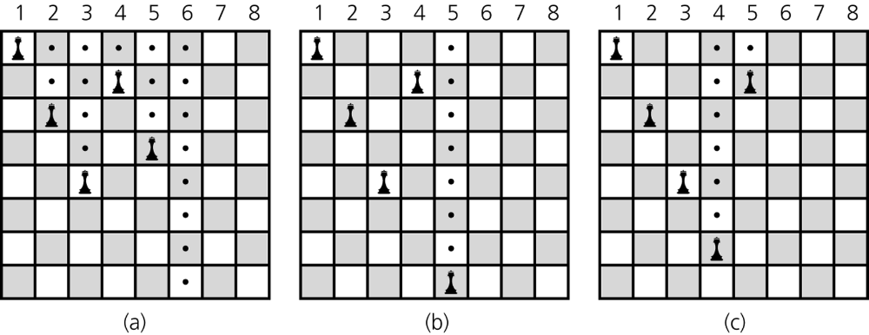
The Eight Queens Problem
Figure 6-1
a) Five queens that cannot attack each other, but that can attack all of
column 6; b) backtracking to column 5 to try another square for the queen;
c) backtracking to column 4 to try another square for the queen and then considering column 5 again

Slide 7
The Eight Queens Problem
A recursive algorithm that places a queen in a column
  Base case
    If there are no more columns to consider
      You are finished
  Recursive step
    If you successfully place a queen in the current column
      Consider the next column
    If you cannot place a queen in the current column
      You need to backtrack

Slide 8
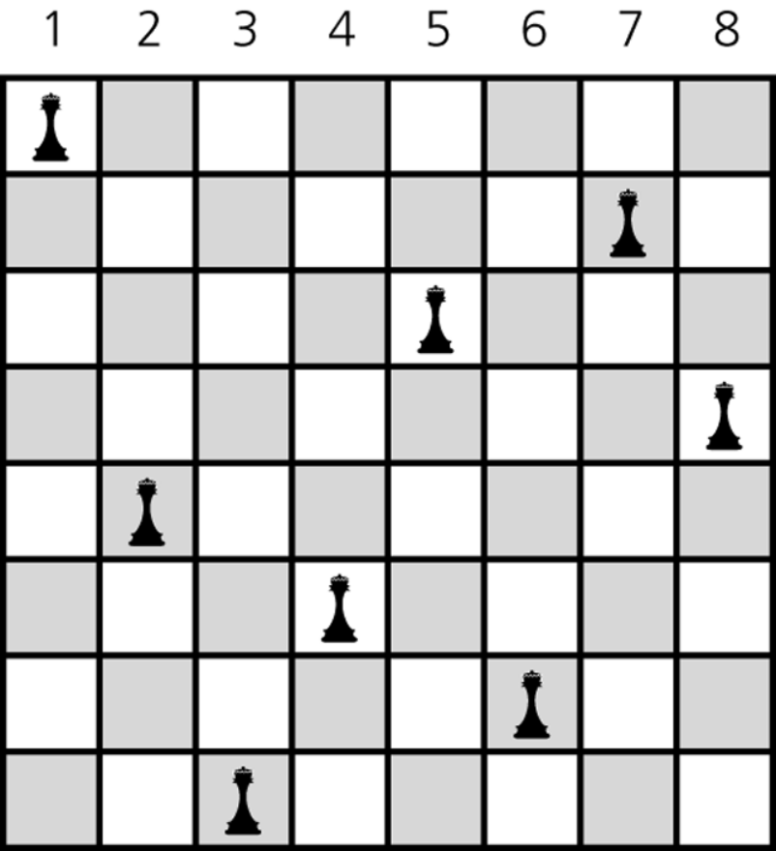
The Eight Queens Problem
Figure 6-2
A solution to the Eight Queens problem

Slide 9
Defining Languages
A language
  A set of strings of symbols
  Examples: English, Java
  If a Java program is one long string of characters, the language JavaPrograms is defined as
  JavaPrograms = {strings w : w is a syntactically correct Java program}

Slide 10
Defining Languages
A language does not have to be a programming or a communication language
  Example
    The set of algebraic expressions
      AlgebraicExpressions = {w : w is an algebraic expression}

Slide 11
Defining Languages
Grammar
  States the rules for forming the strings in a language
Benefit of recursive grammars
  Ease of writing a recognition algorithm for the language
    A recognition algorithm determines whether a given string is in the language

Slide 12
The Basics of Grammars
Symbols used in grammars
  x | y means x or y
  x y means x followed by y
  (In x • y, the symbol • means concatenate, or append)
  < word > means any instance of word that the definition defines

Slide 13
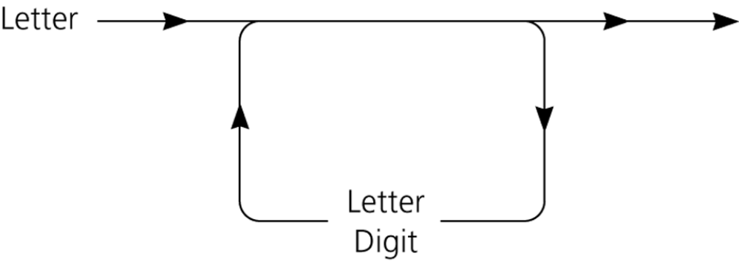
The Basics of Grammars
Java identifiers
  A Java identifier begins with a letter and is followed by zero or more letters and digits
Figure 6-3
A syntax diagram for Java identifiers

Slide 14
The Basics of Grammars
Java identifiers
  Language
  JavaIds = {w : w is a legal Java identifier}
  Grammar
    < identifier > = < letter > | < identifier > < letter > | < identifier > < digit>
    < letter > = a | b | … | z | A | B | …| Z | _ | $
    < digit > = 0 | 1 | … | 9

Slide 15
The Basics of Grammars
Recognition algorithm
  isId(w)
  if (w is of length 1) {
  if (w is a letter) {
  return true
  }
  else {
  return false
  }
  }
  else if (the last character of w is a letter or a digit) {
  return isId(w minus its last character)
  }
  else {
  return false
  }

Slide 16
Two Simple Languages: Palindromes
A string that reads the same from left to right as it does from right to left
Examples: radar, deed
Language
  Palindromes = {w : w reads the same left to right as
    right to left}

Slide 17
Palindromes
Grammar
  < pal > = empty string | < ch > | a < pal > a | b < pal > b | …
    | Z < pal > Z
  < ch > = a | b | … | z | A | B | … | Z

Slide 18
Palindromes
Recognition algorithm
  isPal(w)
  if (w is the empty string or w is of length 1) {
  return true
  }
  else if (w’s first and last characters are the same letter ) {
  return isPal(w minus its first and last characters)
  }
  else {
  return false
  }

Slide 19
Strings of the form A^{n}B^{n}
A^{n}B^{n}
  The string that consists of n consecutive A’s followed by n consecutive B’s
Language
  L = {w : w is of the form A^{n}B^{n} for some n ≥ 0}
Grammar
  < legal-word > = empty string | A < legal-word > B

Slide 20
Strings of the form A^{n}B^{n}
Recognition algorithm
  isAnBn(w)
  if (the length of w is zero) {
  return true
  }
  else if (w begins with the character A and ends with the character B) {
  return isAnBn(w minus its first and last characters)
  }
  else {
  return false
  }

Slide 21
Algebraic Expressions
Three languages for algebraic expressions
  Infix expressions
    An operator appears between its operands
    Example: a + b
  Prefix expressions
    An operator appears before its operands
    Example: + a b
  Postfix expressions
    An operator appears after its operands
    Example: a b +

Slide 22
Algebraic Expressions
To convert a fully parenthesized infix expression to a prefix form
  Move each operator to the position marked by its corresponding open parenthesis
  Remove the parentheses
  Example
    Infix expression: ((a + b) * c
    Prefix expression: * + a b c

Slide 23
Algebraic Expressions
To convert a fully parenthesized infix expression to a postfix form
  Move each operator to the position marked by its corresponding closing parenthesis
  Remove the parentheses
  Example
    Infix form: ((a + b) * c)
    Postfix form: a b + c *

Slide 24
Algebraic Expressions
Prefix and postfix expressions
  Never need
    Precedence rules
    Association rules
    Parentheses
  Have
    Simple grammar expressions
    Straightforward recognition and evaluation algorithms

Slide 25
Prefix Expressions
Grammar
  < prefix > = < identifier > | < operator > < prefix > < prefix >
  < operator > = + | - | * | /
  < identifier > = a | b | … | z
A recognition algorithm
  isPre()
  size = length of expression strExp
  lastChar = endPre(0, size – 1)
  if (lastChar >= 0 and lastChar == size-1 {
  return true
  }
  else {
  return false
  }

Slide 26
Prefix Expressions
An algorithm that evaluates a prefix expression
  evaluatePrefix(strExp)
  ch = first character of expression strExp
  Delete first character from strExp
  if (ch is an identifier) {
  return value of the identifier
  }
  else if (ch is an operator named op) {
  operand1 = evaluatePrefix(strExp)
  operand2 = evaluatePrefix(strExp)
  return operand1 op operand2
  }

Slide 27
Postfix Expressions
Grammar
  < postfix > = < identifier > | < postfix > < postfix > < operator>
  < operator > = + | - | * | /
  < identifier > = a | b | … | z
At high-level, an algorithm that converts a prefix expression to postfix form
  if (exp is a single letter) {
  return exp
  }
  else {
  return postfix(prefix1) + postfix(prefix2) + operator
  }

Slide 28
Postfix Expressions
A recursive algorithm that converts a prefix expression to postfix form
  convert(pre)
  ch = first character of pre
  Delete first character of pre
  if (ch is a lowercase letter) {
  return ch as a string
  }
  else {
  postfix1 = convert(pre)
  postfix2 = convert(pre)
  return postfix1 + postfix2 + ch
  }

Slide 29
Fully Parenthesized Expressions
To avoid ambiguity, infix notation normally requires
  Precedence rules
  Rules for association
  Parentheses
Fully parenthesized expressions do not require
  Precedence rules
  Rules for association

Slide 30
Fully Parenthesized Expressions
Fully parenthesized expressions
  A simple grammar
  < infix > = < identifier > | (< infix > < operator > < infix > )
  < operator > = + | - | * | /
  < identifier > = a | b | … | z
  Inconvenient for programmers

Slide 31
The Relationship Between Recursion and Mathematical Induction
A strong relationship exists between recursion and mathematical induction
Induction can be used to
  Prove properties about recursive algorithms
  Prove that a recursive algorithm performs a certain amount of work

Slide 32
The Correctness of the Recursive Factorial Method
Pseudocode for a recursive method that computes the factorial of a nonnegative integer n
  fact(n)
  if (n is 0) {
  return 1
  }
  else {
  return n * fact(n – 1)
  }

Slide 33
The Correctness of the Recursive Factorial Method
Induction on n can prove that the method fact returns the values
  fact(0) = 0! = 1
  fact(n) = n! = n * (n – 1) * (n – 2) * …* 1 if n > 0

Slide 34
The Cost of Towers of Hanoi
Solution to the Towers of Hanoi problem
  solveTowers(count, source, destination, spare)
  if (count is 1) {
  Move a disk directly from source to destination
  }
  else {
  solveTowers(count-1, source, spare, destination)
  solveTowers(1, source, destination, spare)
  solveTowers(count-1, spare, destination, source)
  }

Slide 35
The Cost of Towers of Hanoi
Question
  If you begin with N disks, how many moves does solveTowers make to solve the problem?
Let
  moves(N) be the number of moves made starting with N disks
When N = 1
  moves(1) = 1

Slide 36
The Cost of Towers of Hanoi
When N > 1
  moves(N) = moves(N – 1) + moves(1) + moves(N – 1)
Recurrence relation for the number of moves that solveTowers requires for N disks
  moves(1) = 1
  moves(N) = 2 * moves(N – 1) + 1 if N > 1

Slide 37
The Cost of Towers of Hanoi
A closed-form formula for the number of moves that solveTowers requires for N disks
  moves(N) = 2^{N} – 1, for all N ≥ 1
Induction on N can provide the proof that moves(N) = 2^{N} – 1

Slide 38
Summary
Backtracking is a solution strategy that involves both recursion and a sequence of guesses that ultimately lead to a solution
A grammar is a device for defining a language
  A language is a set of strings of symbols
  A recognition algorithm for a language can often be based directly on the grammar of the language
  Grammars are frequently recursive

Slide 39
Summary
Different languages of algebraic expressions have their relative advantages and disadvantages
  Prefix expressions
  Postfix expressions
  Infix expressions
A close relationship exists between mathematical induction and recursion
  Induction can be used to prove properties about a recursive algorithm

